Slide 1
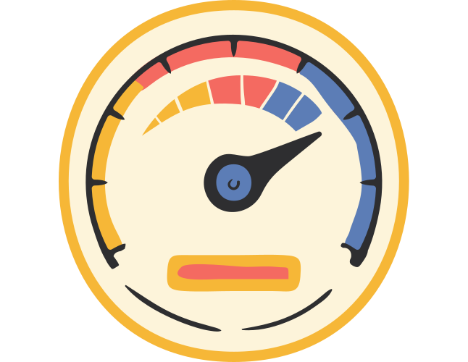
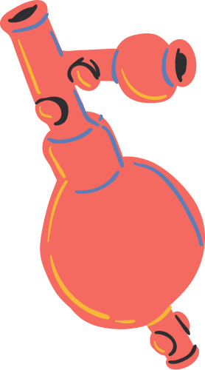
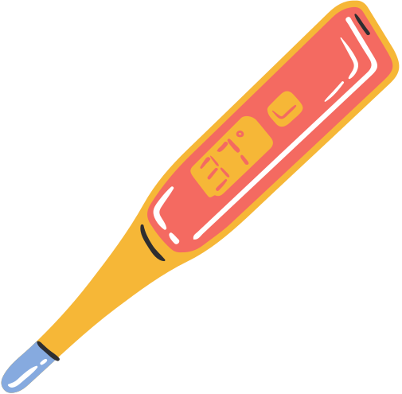
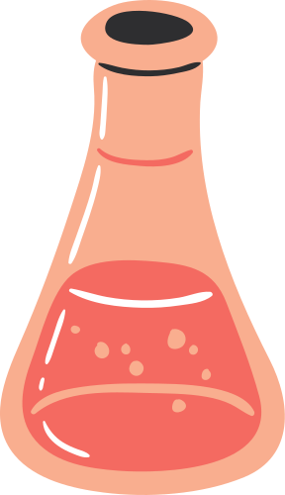


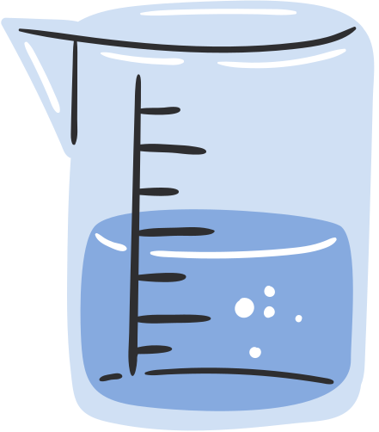
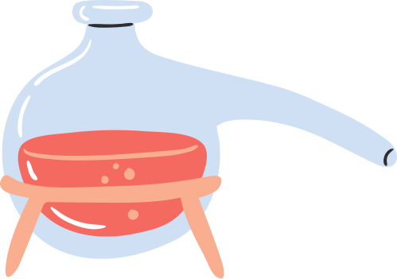
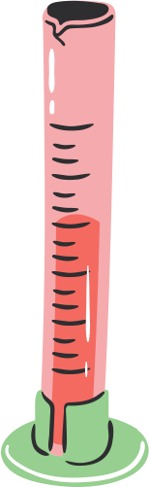
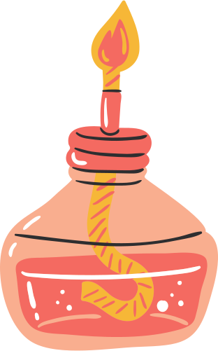
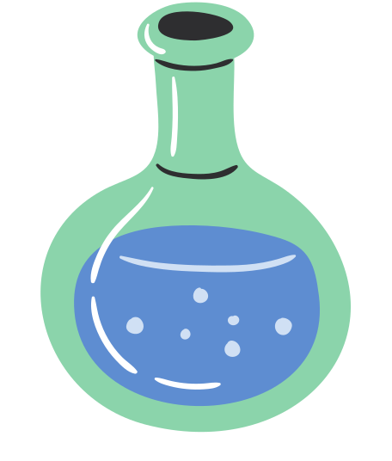

Elixir Wednesday
Wednesday, Oct 11th 2023
🍣 🍻 🧪 🍟 🎤 🚀

Slide 2
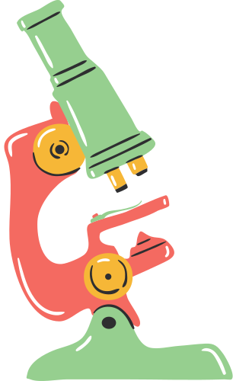
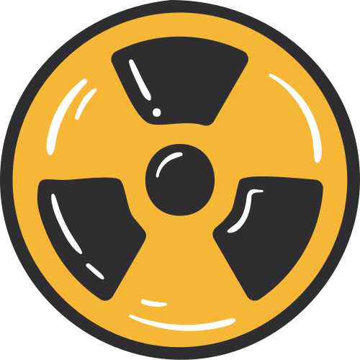
Today's Agenda
Definition of laboratory equipment
Common laboratory equipment
Purpose of different laboratory equipment

Slide 3


Objectives
Identify the common laboratory equipment used in a laboratory.
Enumerate common pieces of laboratory equipment and their usage.
Know the importance and proper handling of common laboratory equipment.

Slide 4
Laboratory
Equipment

Slide 5
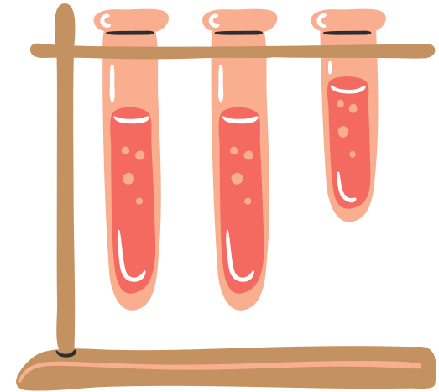
Laboratory Equipment
A laboratory equipment is used to conduct and perform scientific experiments.
These pieces of equipment vary from simple to complex depending on the type of experiment done in the laboratory.

Slide 6
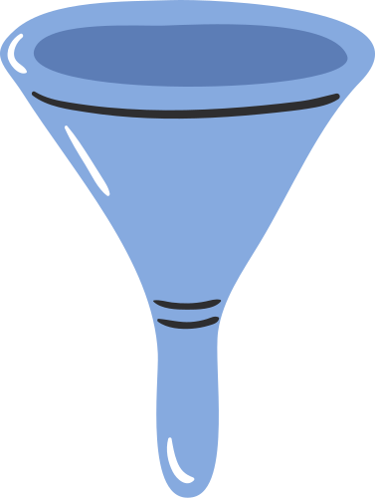
Laboratory Equipment
Importance
Purpose
Lab equipment aids students to experience first-hand experiments rather than just reading the processes and execution.
Lab equipment allows students to use their scientific thinking and apply theoretical experiments in real life.

Slide 7
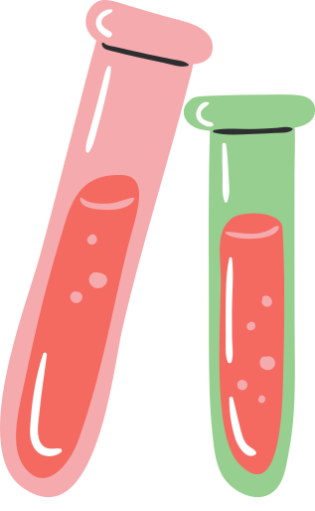
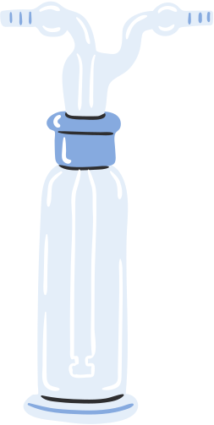

Test tube
Pipette Bulb
Gas Bottle
These are used to store, mix and observe small amount of solid or liquid samples.
This equipment allows the collection and transfer of liquid samples.
This collects gas when large amount of gas is produced during an experiment.

Slide 8
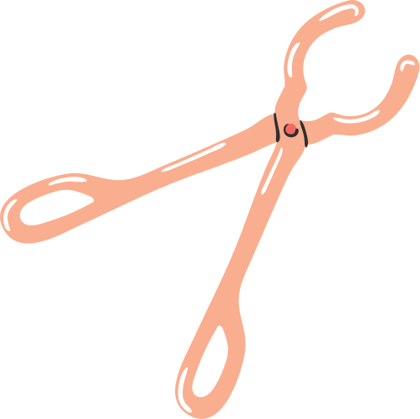

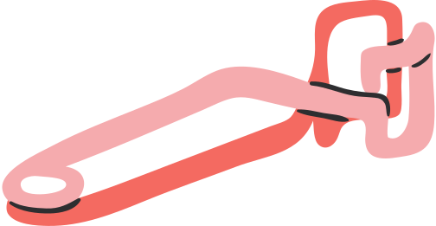
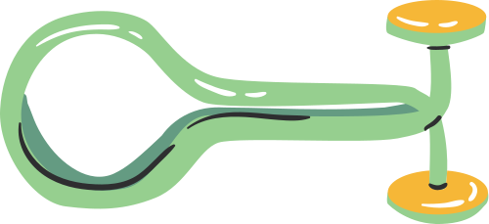
Pinch Clamp
Crucible Tong
Test tube Holder
This equipment is used to stop the flow of liquid in a rubber or plastic tubing.
This equipment allows you to hold hot vessels such as crucibles, flasks and disks.
This equipment is used to indirectly hold test tubes during a heating process.

Slide 9

Florence Flask
Retort Flask
Erlenmeyer Flask
This flask is useful in observing chemicals and heating solutions.
This flask is used for the purpose of distillation process.
This flask is useful in titration process and also useful in mixing because there is a low chance of spill.

Slide 10
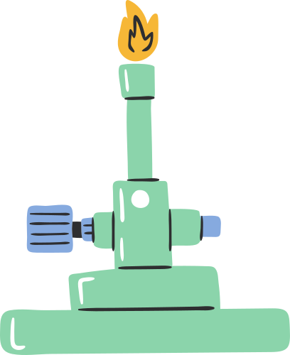

Bunsen Burner
Alcohol Burner
This equipment fire hazard for it produce open flame and used for heating and sterilization process.
This heating equipment is an alternative when there is natural gas available in the laboratory.

Slide 11
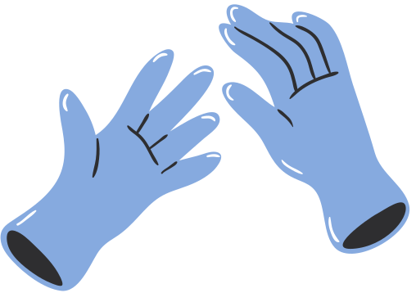
Wrap Up!
A laboratory equipment is used to conduct and perform scientific experiments.
These pieces of equipment vary from simple to complex depending on the type of experiment done in the laboratory.
These pieces of equipment should handle with care and under professional supervision inside laboratory.

Slide 12
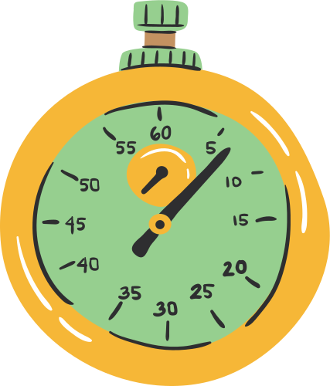
Thank you for being attentive!

Slide 13
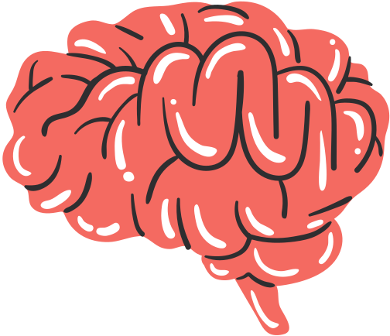
References:
Ketut Susilo (2017)
Rosa Maria Aguado (2019)
Yanis Petros (2022)

Slide 14
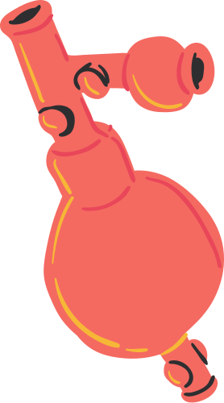
Resource Page

